Slide 1
Introduction to Hibernate
Session - 1

Slide 2
Introduction
Open source object/relational mapping tool for java
Lets you develop persistent classes following common java idiom including
  Association
  Inheritance
  Polymorphism
  Composition
  And the java collection framework

Slide 3
Introduction
Takes care of the mapping from java classes to database tables and from java data types to SQL data types
Provides data query and retrieval facilities and can significantly reduce development time otherwise spent with manual data handling in SQL and JDBC

Slide 4
Goal
To relieve the developer from 95 % of common data persistence related programming tasks

Slide 5
Features of Hibernate
Hibernate 3.0 provides three full-featured query facilities
  Hibernate Query Language
  Hibernate Criteria Query API
  Enhanced support for queries expressed in the native SQL dialect of the database
Filters for working with temporal, regional and permissioned data
Runtime performance monitoring: via JMX or local Java API
Eclipse Support

Slide 6
Features of Hibernate
Scalable
Less Development Time
Automatic Key Generation
JDK 1.5 Enhancements:
EJB3-style persistent operations
Hibernate XML binding enables data to be represented as XML and POJOs interchangeably
EJB3 draft specification support for POJO persistence and annotations

Slide 7
Hibernate Architecture
Application
Persistent Objects
Hibernate
Hibernate
properties
XML
Mapping
Database

Slide 8
Overview of Hibernate
Makes use of persistent objects commonly called as POJO along with XML mapping documents for persistent objects to the database layer
Rather than utilizing byte code processing or code generation, hibernate uses runtime reflection to determine the persistent properties of a class
The objects to be persisted are defined in a mapping document, which serves to describe the persistent fields and association, as well as sub classes or proxies of the persistent object

Slide 9
Overview of Hibernate
The mapping documents are compiled at application startup time and provide the framework with necessary information for a class.
Additionally, they are used in support operations, such as generating the database schema or creating stub java source files

Slide 10
Hibernate Architecture Components
Connection Management
Transaction Management
Object relational mapping
Notes:
Connection Management
Hibernate connection management service provide efficient management of the database connections. Database connection is the most expensive part of interacting with the database as it requires a lot of resources of open and close the database connection
Transaction Management
Transaction Management service provide the ability to the user to execute more than one database statements at a time
Object relational mapping
Object relational mapping is technique of mapping the data representation from an object model to a relational data model.
This part of the hibernate is used to select, insert, update and delete the records from the underlying table.
When we pass an object to a Session.save() method, Hibernate reads the state of the variables of that object and executes the necessary query.

Slide 11
Steps for developing first hibernate application
Create a database schema

Slide 12
Creating Database Schema
create database testdb;
use testdb;
create table Contact (
contactID integer primary key auto_increment,
firstName varchar(255) not null,
lastName varchar(255) not null,
email varchar(255) not null);

Slide 13
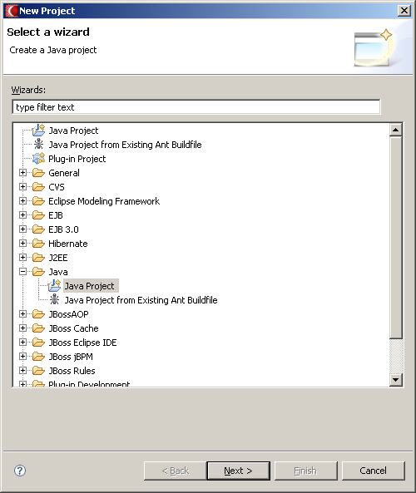
Create a new java project

Slide 14
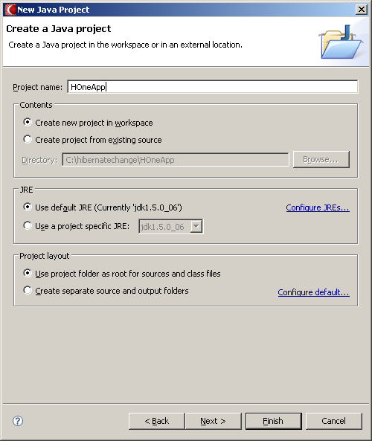
Select a Project Name

Slide 15
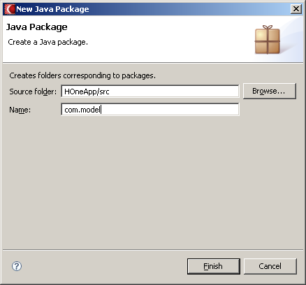
Create a package – com.model

Slide 16
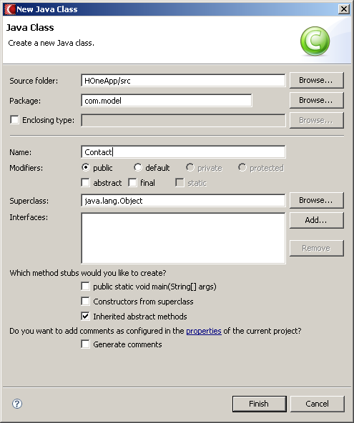
Create a POJO - Contact

Slide 17
Contact.java
package com.model;
public class Contact {
private long contactID;
private String firstName;
private String lastName;
private String email;
public long getContactID() {
return contactID;
}
public void setContactID(long contactID) {
this.contactID = contactID;
}
public String getEmail() {
return email;
}
public void setEmail(String email) {
this.email = email;
}

Slide 18
Contact.java
public String getFirstName() {
return firstName;
}
public void setFirstName(String firstName) {
this.firstName = firstName;
}
public String getLastName() {
return lastName;
}
public void setLastName(String lastName) {
this.lastName = lastName;
}
}

Slide 19
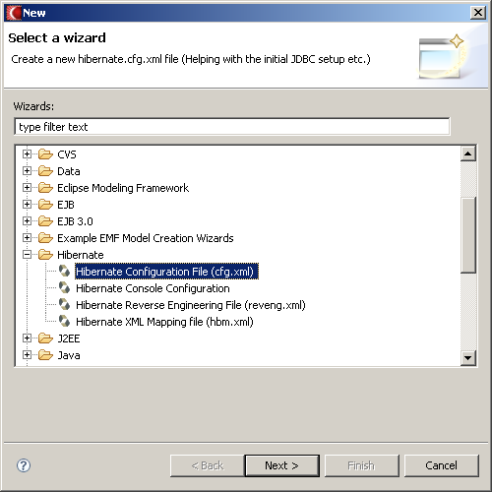
Create Hibernate configuration file

Slide 20
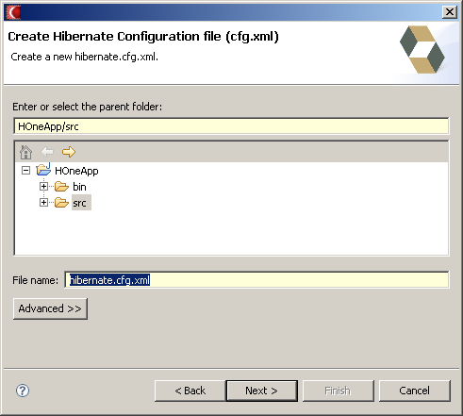
Hibernate configuration file

Slide 21
Hibernate configuration file
<?xml version="1.0" encoding="UTF-8"?>
<!DOCTYPE hibernate-configuration PUBLIC
"-//Hibernate/Hibernate Configuration DTD 3.0//EN"
"http://hibernate.sourceforge.net/hibernate-configuration-3.0.dtd">
<hibernate-configuration>
<session-factory>
<property name="connection.driver_class">com.mysql.jdbc.Driver</property>
<property name="connection.url"> jdbc:mysql://localhost:3306/testdb </property>
<property name="connection.username">root</property>
<property name="connection.password"> </property>
<property name="hibernate.dialect">org.hibernate.dialect.MySQLDialect
</property>
<property name="connection.pool_size">1</property>
<property name="show_sql">true</property>
<property name="current_session_context_class">thread</property>
<mapping resource="com/model/Contact.hbm.xml"/>
</session-factory>
</hibernate-configuration>

Slide 22
<hibernate-mapping> element
The first or root element of hibernate mapping document is <hibernate-mapping> element
Between the <hibernate-mapping> tag class element(s) are present

Slide 23
<class> element
The <class> element maps the class object with corresponding entity in the database
It also tells what table in the database has to access and what column in that table it should use
Within one <hibernate-mapping> element, several <class> mappings are possible

Slide 24
<id> element
The <id> element is unique identifier to identify and object. In fact <id> element map with the primary key of the table
In our code:
  <id name=“contactID” type=“long” column=“contactID”>
Primary key maps to the ID field of the table CONTACT. The attributes of the id element are:
  name – The property name used by the persistent class
  column – the column used to store the primary key value
  type – the java data type used
  unsaved-value – this is the value used to determine if a class has been made persistent. If the value of the id attribute is null, then it means that this object has not been persistend

Slide 25
<generator> element
The <generator> element method is used to generate the primary key for the new record
Commonly used generators
  Increment
    Used to generate primary keys of type long, short or int that are unique only
    Not used in the clustered environment
  Sequence
    Uses the sequences to generate the primary key
    Used with db2, PostgreSQL, Oracle, SQP DB databases
  Assigned
    Used when the application code generates the primary key

Slide 26
List of commonly used generators in hibernate
increment
identity
sequence
hilo
seqhilo
uuid
guid
native
assigned
select
foreign

Slide 27
<property> element
The property elements define standard java attributes and their mapping into database schema
The property element supports the column child element to specify additional properties, such as the index name on a column or a specific column type

Slide 28
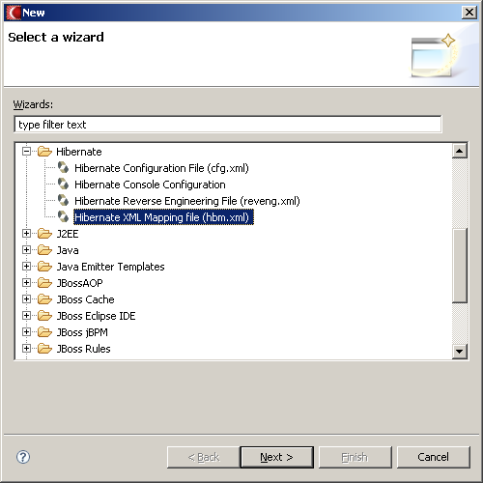
Object/ Relational Mapping

Slide 29
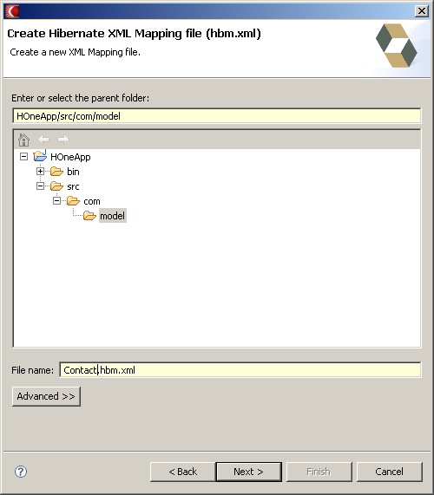
Contact.hbm.xml

Slide 30
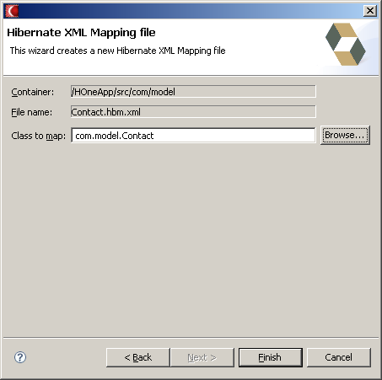
Mapping the class

Slide 31
Contact.hbm.xml
<?xml version="1.0"?>
<!DOCTYPE hibernate-mapping PUBLIC
"-//Hibernate/Hibernate Mapping DTD 3.0//EN"
"http://hibernate.sourceforge.net/hibernate-mapping-3.0.dtd">
<hibernate-mapping package="com.model">
<class name="Contact" table="contact">
<id name="contactID" column="contactID">
<generator class="native"/>
</id>
<property name="firstName" column="firstName" type="java.lang.String"/>
<property name="lastName" column="lastName" type="java.lang.String"/>
<property name="email" column="email" type="java.lang.String"/>
</class>
</hibernate-mapping>

Slide 32
Inserting Contact Record
import org.hibernate.Session;
import org.hibernate.SessionFactory;
import org.hibernate.cfg.Configuration;
import com.model.Contact;
public class Test {
public static void main(String[] args) {
try {
SessionFactory sessionFactory =
new Configuration().configure().buildSessionFactory();
Session session = sessionFactory.openSession();
session.beginTransaction();
Contact c1 = new Contact();

Slide 33
Inserting Contact Record
c1.setFirstName("Achalla");
c1.setLastName("Rama Krishna");
c1.setEmail("achalla@enterprisepatterns.com");
session.save(c1);
session.getTransaction().commit();
System.out.println("success");
session.close();
}catch(Exception e) {
e.printStackTrace();
}
}
}

Slide 34
Querying the Contact Table
import org.hibernate.Session;
import org.hibernate.SessionFactory;
import org.hibernate.cfg.Configuration;
import com.model.Contact;
public class QueryTest {
public static void main(String[] args) {
try {
SessionFactory sessionFactory =
new Configuration().configure().buildSessionFactory();
Session session = sessionFactory.openSession();
session.beginTransaction();

Slide 35
Querying the Contact Table
Contact c1 = null;
List list = session.createQuery("from Contact").list();
for(int i=0; i<list.size(); i++) {
c1 = (Contact)list.get(i);
System.out.println("Name - " + c1.getFirstName() + " "
+ c1.getLastName());
System.out.println("Email ID - " + c1.getEmail());
}
session.getTransaction().commit();
System.out.println("success");
session.close();
}catch(Exception e) {
e.printStackTrace();
}
}
}

Slide 36
Updating Contact Record
import org.hibernate.Session;
import org.hibernate.SessionFactory;
import org.hibernate.cfg.Configuration;
import com.model.Contact;
public class Test {
public static void main(String[] args) {
try {
SessionFactory sessionFactory =
new Configuration().configure().buildSessionFactory();
Session session = sessionFactory.openSession();
session.beginTransaction();
Contact c1 = new Contact();

Slide 37
Updating Contact Record
c1.setContactID(2);
c1.setLastName(“Tendulkar");
c1.setEmail(“sachin@enterprisepatterns.com");
session.update(c1);
session.getTransaction().commit();
System.out.println("success");
session.close();
}catch(Exception e) {
e.printStackTrace();
}
}
}

Slide 38
Deleting Contact Record
import org.hibernate.Session;
import org.hibernate.SessionFactory;
import org.hibernate.cfg.Configuration;
import com.model.Contact;
public class Test {
public static void main(String[] args) {
try {
SessionFactory sessionFactory =
new Configuration().configure().buildSessionFactory();
Session session = sessionFactory.openSession();
session.beginTransaction();
Contact c1 = new Contact();

Slide 39
Deleting Contact Record
c1.setContactID(2);
session.delete(c1);
session.getTransaction().commit();
System.out.println("success");
session.close();
}catch(Exception e) {
e.printStackTrace();
}
}
}

